Slide 1
Solution approach and algorithm
How does our system work?
Team: Hello World Members: Ishan Bharath; Amogh Ashwin Amin; Jayadev Manoj Kamath
Our approach
Assumptions and choices
Pipeline: M1 portals -> M2 routing matrices -> M3 joint optimizer -> M4 validator + blueprint.
M1 verifies every door/open passage geometrically (room polygons x door geoms) and calibrates raw coordinates to metres (median door width ~0.9 m). M2 routes wall-hugging cable inside each room and precomputes all-pairs matrices D (true indoor length, m) and B (90-degree bends) between devices and candidate panel wall spots.
Name the algorithm you use for each part:
hubs and zones: BFS region-growing partition, contiguity guarded via articulation points | node order: 2-opt TSP on the D matrix | routing: orthogonal Dijkstra on buffered room interiors | crossings/overlap/bends: doorway in/out offset paths, panel snapped onto a wall next to the optimal tour (Loop-First, Panel-Snap)
Why: all expensive geometry is precomputed once per plan, so the joint optimisation (panel count, zones, loop order, panel spot) runs in ~0.02 s on exact metres - validity by construction, optimality on the real metric.
Where cable may run: only along walls - raceways inside each room's interior buffer (~0.23 m clearance); rooms never share boundary lines, so every transition goes through a verified portal.
Hub (panel) points: candidate spots on interior walls alongside an edge of the optimal loop; living-room / corridor entry walls preferred.
Room with one door: cable passes through the same doorway twice; in/out paths offset by +/-8 cm so the loop stays a simple, non-self-intersecting polygon.
Note anything you read differently from the problem statement.
Intermediate update | Team: Hello World | 1 / 3

Slide 2
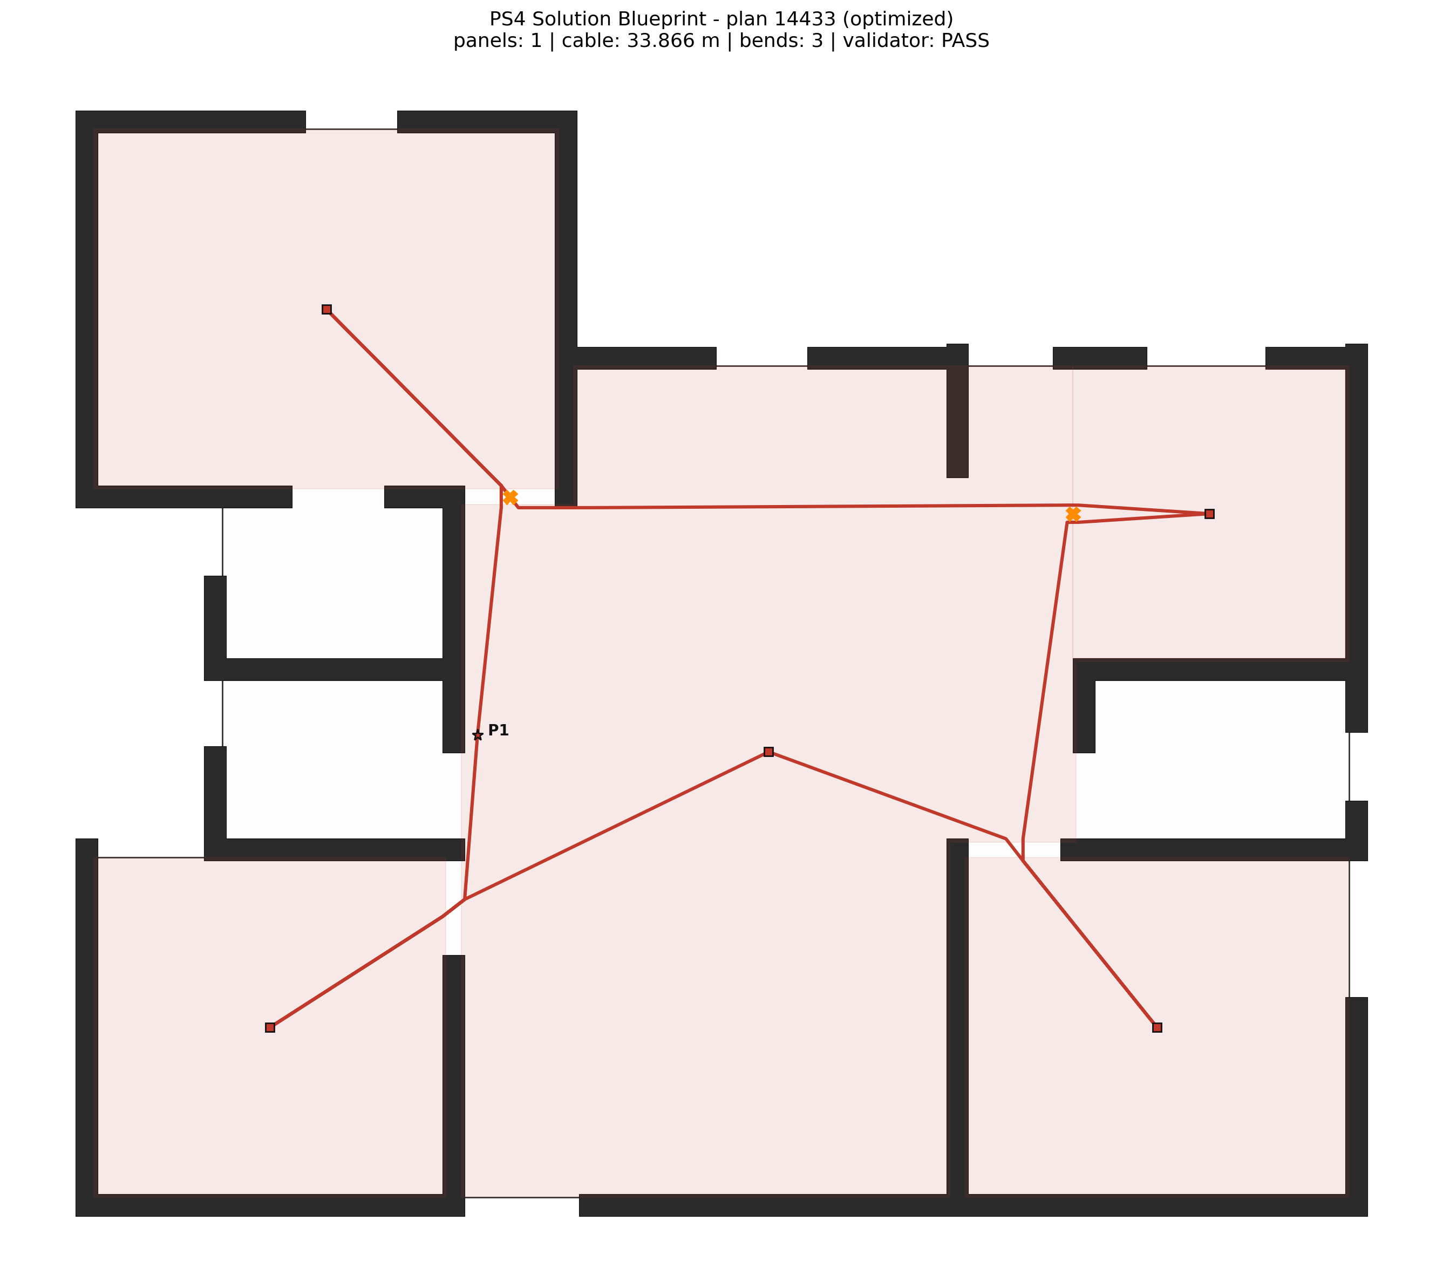
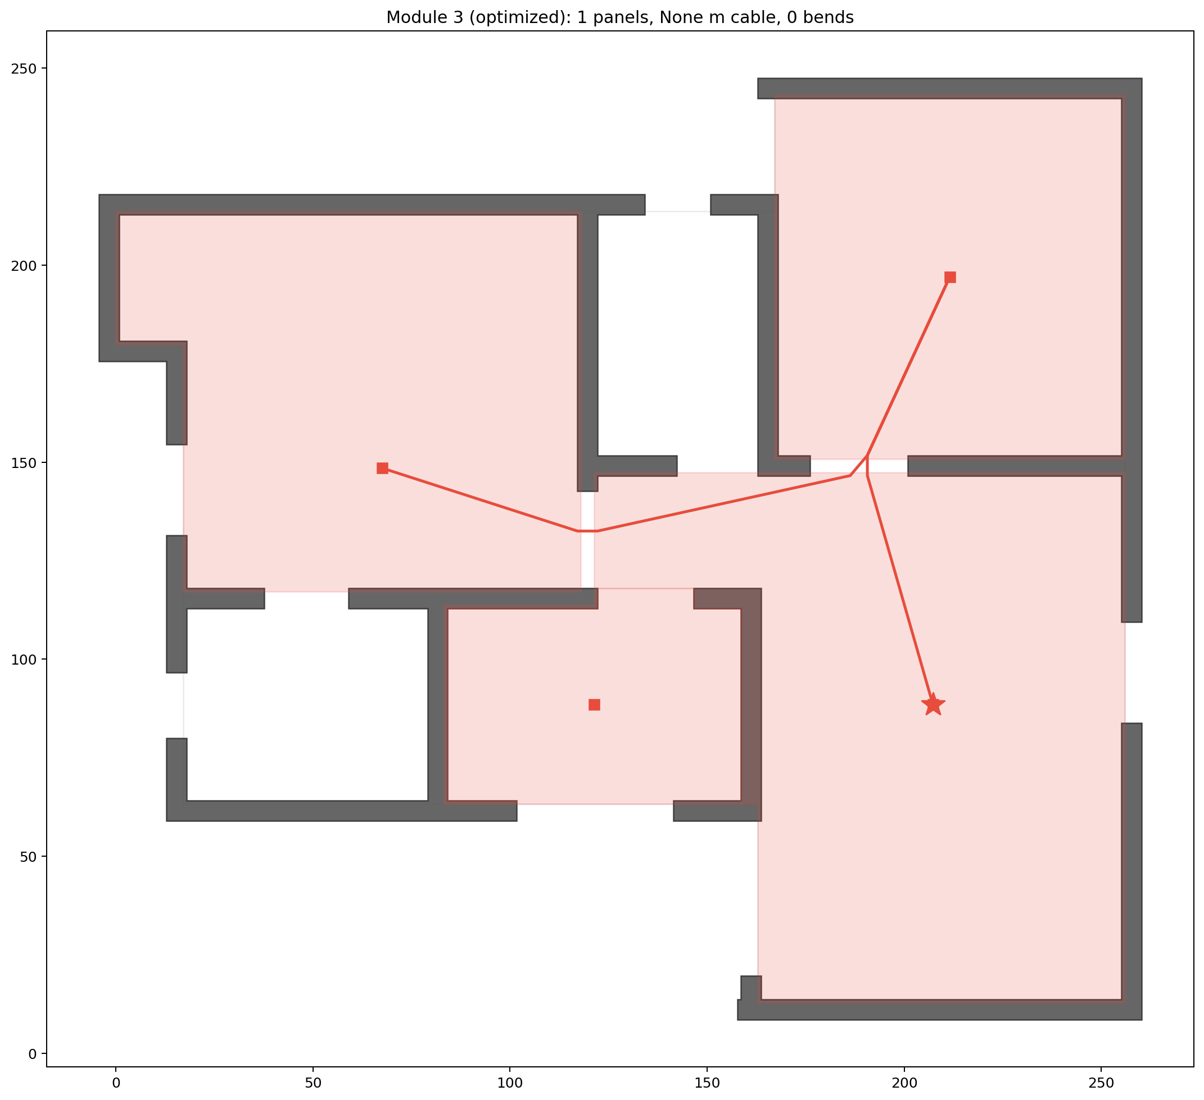
Current progress and screenshots
What works today? Show it, and show what does not.
Where we are
What works:
Full pipeline M1->M4 runs end-to-end on 20 smoke-test plans; 16 produced complete validated solutions. Optimized output valid on 15/16 (baseline 14/16). Contiguous zones, closed loops through real doorways only, CAD-style blueprint + JSON per plan.
What does not work yet:
4/20 plans fail in M3/M4 (unroutable loop or crash). Plan 14926 optimized: loop does not close and living_0 is left unvisited (right image). Baseline can break the 100 m2 cap (plan 2373: 107 m2) and contiguity (plan 10808).
Results (16 completed plans):
Valid: optimized 15/16 vs baseline 14/16. Cable: optimized shorter than baseline in 14/14 comparable plans - mean 6.1%, up to 16.1% (plan 7607); on plan 14433: 36.9 m -> 33.9 m. M3 runtime ~0.02 s per plan.
Best result so far
A hard case or a failure
Intermediate update | Team: [Hello World] | 2 / 3

Slide 3
Remaining issues and improvements
What is left to fix, and what could go beyond the current scope?
Remaining issues current scope
Improvements beyond scope ideas, not built
1. Loop-closure bug [could stop us]: on plan 14926 the 2-opt reorder drops the return leg to living_0 -> loop not closed, device missed. Fix: re-validate the closure edge after every 2-opt move; fall back to the pre-swap order if broken.
2. 4/20 plans fail in M3/M4 (unroutable loops on tight portals / crash later in the chain). Fix: per-portal clearance fallback + failure guard rails in the runner.
4. Bends are only counted, not optimised. Fix: add bend weight to the TSP cost (B matrix already available).
5. Area-cap edge cases: baseline exceeds 100 m2 on plan 2373; star-shaped room graphs (14433) can force a capacity violation. Fix: enforce the cap as a hard constraint in partition acceptance.
1. NFPA 72 Class X survivability: avoid reusing the same doorway for out+return when an alternate door exists - pinch points are already flagged, next step is to penalise them in the optimiser.
3. Surface the 24 V voltage-drop check per panel (physics already computed) as a compliance report for installers.
4. Interactive planner UI: drag a panel and see the loop re-route and re-validate live.
Next steps and help needed
Next, in order: 1) fix the 2-opt loop-closure bug and re-run the 20-plan batch; 2) speed up M2 matrix builds; 3) batch 100+ plans for solid statistics; 4) polish blueprint render, JSON export and README before final submission.
Help needed from organisers: none only one clarification would help: are 'via_window' edges ever valid cable paths, or must all transitions go through doors/open passages?
Intermediate update | Team: Hello World | 3 / 3

